Slide 1
Functional decomposition and Concept generation
TEAM-2
G²

Slide 2
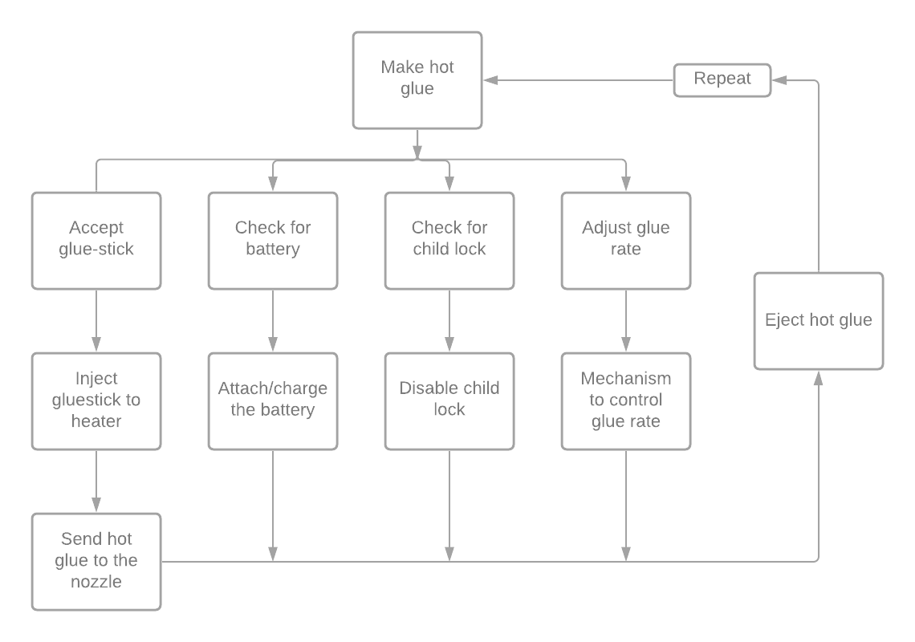
Functional Decomposition:

Slide 3
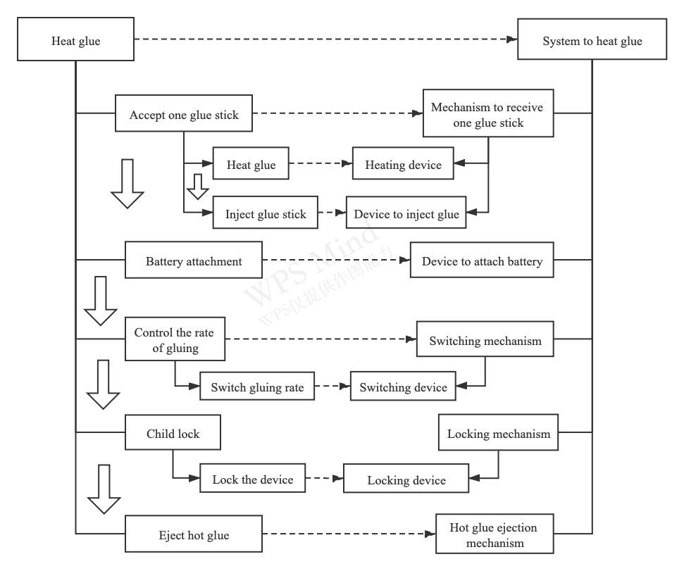
Physical to functional domain map:

Slide 4
S. No. | Battery Attachment | Switch Mechanism | Accept one glue stick. | Child Locking device | Gluing rate controlling device
1 | Snap on battery pack on back. | Push button switch | Two-piece grip | Cover for switch mechanism | Changing nozzle tip
2 | Slide on battery pack on back | Side mounted switch | Concentric rings | Mechanical stop so switch cannot be triggered. | A rotating mechanism to increase or decrease nozzle size.
3 | Battery pack slides in on side with cover. | Center mounted trigger mechanism. | One moving pad and a friction stop for the other side. | Electronic Stop for the switch | Small flap that can cover a part of the nozzle area.
4 | Battery slide on pack but mounts with screws | Side mounted trigger mechanism | Split rings that come together like one concentric ring | Squeeze and twist mechanism to cover the switch. | A digital display with adjustable flow rate.
5 | Inbuilt lithium-ion battery | Shake to switch on. |  | Hard push on the lock button to turn on. | Using a manual injection nozzle (like a syringe) to apply pressure
6 | Heating dock which heats the glue up to it's melting point. | Knob switch |  | Two steps to unlock the glue gun. | A battery-controlled injection nozzle
7 |  | Selection screen switch |  | Stop when detecting long-time running.
8 |  | Bluetooth controlled via an app |  | Fingerprint touch authentication.
Concept Generation:

Slide 5
Thank You

